Slide 1
Field profitability index prediction
PACMANN DS-5 - Team A:
Andi Pratama
Wilson Robert Pariangan
Andrew Wisnujati

Slide 2
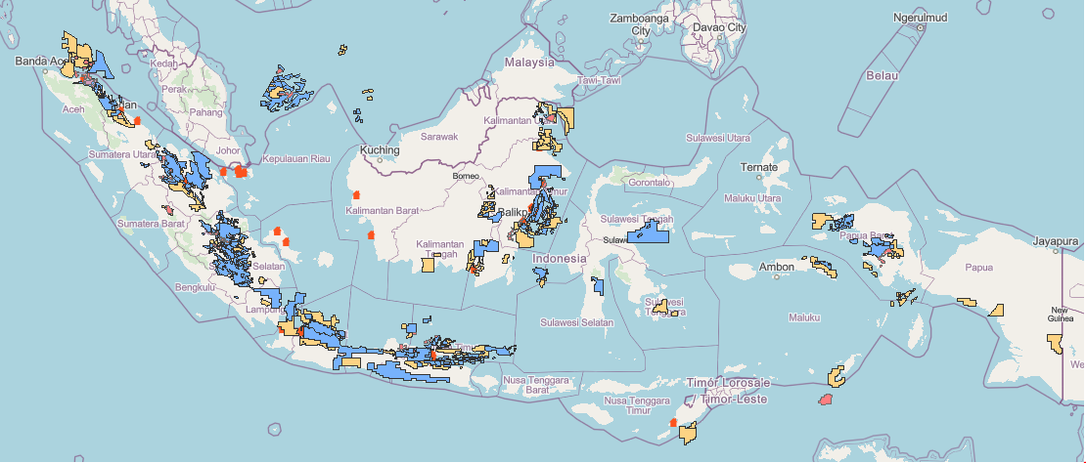
Status 2021*
Notes:
Blue → Exploitation + FID Phase (94 working area of ~900 fields)
Yellow → Exploration Phase (65 working area)
Blue → Known economic status
Yellow → Unknown economic status and need complex analysis to predict
BUT?!
Blue features == Yellow features

Slide 3
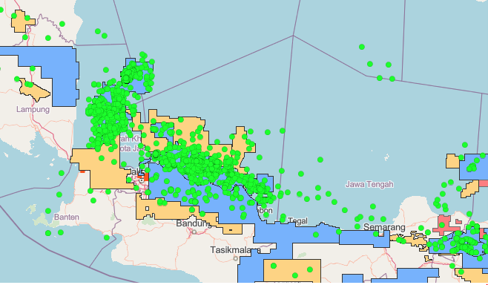
Challenges
Notes:
Blue → Exploitation + FID Phase (94 working area of ~900 fields)
Yellow → Exploration Phase (65 working area)
Green DOT → Wells, where 1 dot could represent 1 exploration field (hard estimate), imagine the complexity!
It would be helpful if engineers have a robust screening method based on existing information to accelerate evaluation & decision by prioritization

Slide 4
Solution?
Blue features == Yellow features
+
Need: Categorizing (PI)
Classification Problem

Slide 5
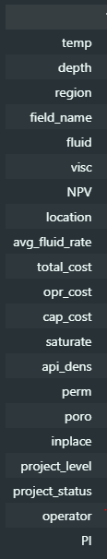
Raw Data
→ ESDC (Indonesian Subsurface Data)

Slide 6
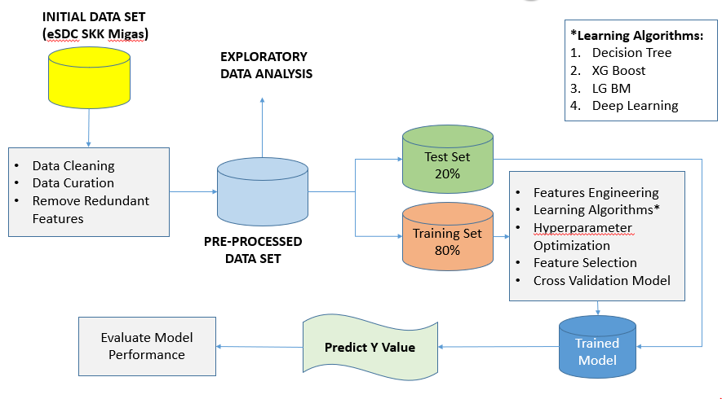
END TO END MODELING FLOW
Deploy
XGBoost

Slide 7
PRE-PROCESSING DATA
Data Cleaning
Input correction on Depth, Temperature & Field Name parameter
Data Curation
Unit Conversion on Inplace, API Density & Average Fluid Rate parameter
Remove Redundant
Remove Project Level, project_level, cap_cost, opr_cost, total_cost, NPV & PI parameter

Slide 8
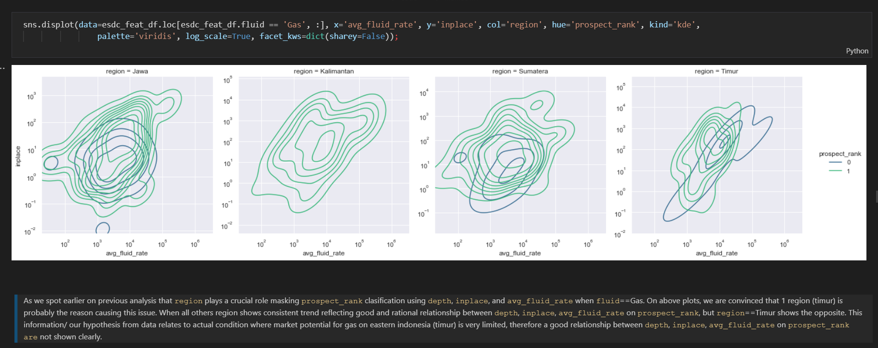
EXPLORATORY DATA ANALYSIS
*Some Meaningful insight

Slide 9
High Level “Insight” from EDA
We suspect there is a causal effect of `inplace` & `avg_fluid_rate` in `prospect_rank`. While we segmented on `fluid` we notice that by having bigger `inplace` and `avg_fluid_rate` could lead us to more preferable economic of scale benefit
When fields are having a deeper reservoir target they need either bigger `inplace` or `avg_fluid_rate` in order to become more economical.
We suspect on `Gas` that either `region` or `location` could play major role to spot non market potential area/ region.
When all others region shows consistent trend reflecting good and rational relationship between `depth`, `inplace`, `avg_fluid_rate` on `prospect_rank`, but `region`==Timur shows the opposite. This information/ our hypothesis from data relates to actual condition where market potential for gas on eastern indonesia (timur) is very limited, therefore a good relationship between `depth`, `inplace`, `avg_fluid_rate` on `prospect_rank are` not shown clearly.
When we have a new field, by ensuring this field to deliver significant high rate (above 1000 BOPD.E) might lead us to get a better chance having profitable project regardless their location if fluid type is oil but it might not work for gas if it is located at offshore.
Kalimantan is the most preferable `region` to produce hidrocarbon on offshore, whenever the `avg_fluid_rate`, We might have profitable project, especially when `avg_fluid_rate` > 1000 BOPD.E.
`avg_fluid_rate` >= 1000 BOPD.E could be used as profitable economic cutoff for `fluid`==Oil & `fluid`==Oil&Gas on any kind of regions and location.
Beside Kalimantan, all gas field projects on offshore have strong tendency to be less profitable when those fields could produce over 1000 BOPD.E. It might be an early indication that those regions have market/ infrastructure issues related to gas.
ince Pertamina has more diverse field than others it might improve Pertamina's portofolio
When it comes to gas project, more projects have better profitability under Pertamina than others. This condition might exist probably because of project integration, market readiness, and sound infrastructure alignment inside Pertamina business unit
On oil project, neither Pertamina nor others could deliver better performance on profitabilty but we might use `avg_fluid_rate` > 1000 BOPD.E as economic cutoff.

Slide 10
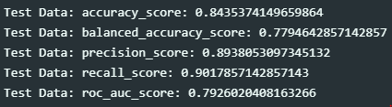
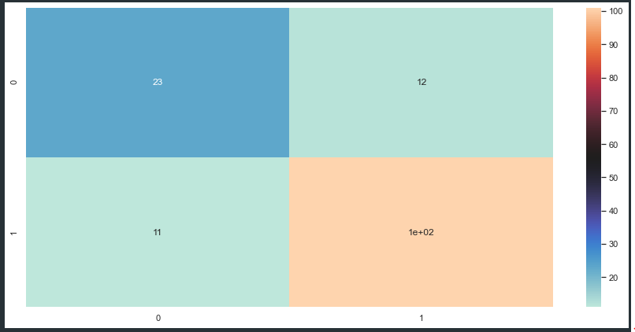
Model Performance (Final: XGboost)

Slide 11
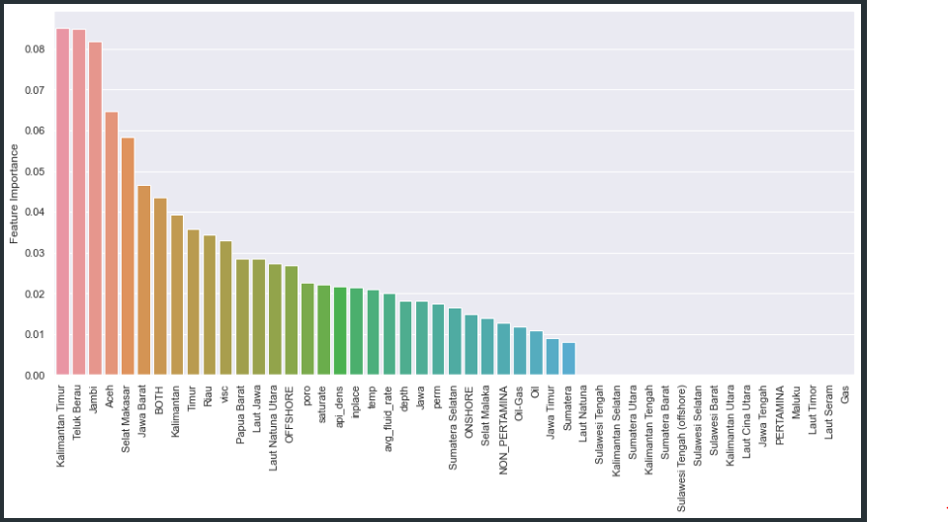
Features Importance
Region/ Location
Play important ROLE!

Slide 12
User Flow
Screening & Prioritizing Process
0 | Marginal
(prob ?)
Users:
1.Engineers
2. Field Development team
3. New Ventures
Exploration Field Features
Apps
1 | Profitable
(prob ?)
Notes:
App → https://peaceful-ravine-66425.herokuapp.com/docs#/
GitHub → https://github.com/aprds/field_profitability_index
RESULT

Slide 13
Conclusion
XGBoost has been selected as model ready and has been deployed on Heroku
Decision to select XGBoost is based on its reability in term of acceptable roc_auc_score ~0.80, high recall_score ~0.90 which is suitable to identify prospective fields as many as possible to be developed, high precision_score ~0.89 obtained relative to recall_score, therefore, could help users to find real/ true prospective fields in timely manner with minimal re-evaluation job, furthermore, on its capability to allow engineer doing iteration, finetuning and optimization as fast as possible
Information from trees in XGBoost combined with features_importances could help engineer getting meaningful insight related to intrinsic factors that could effect field prospective index. Also, by using these trees, engineer could weight their focus on certain aspects to increase their odd finding the profitable oil & gas assets

Slide 14

DEMO
Field Profitability Index Prediction

